Slide 1

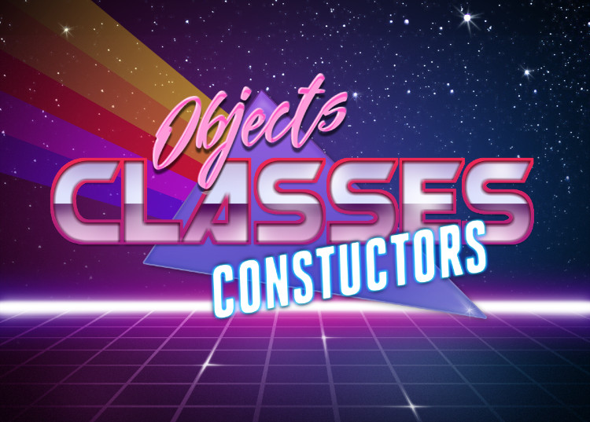
Mark Daniel g. Dacer

Slide 2
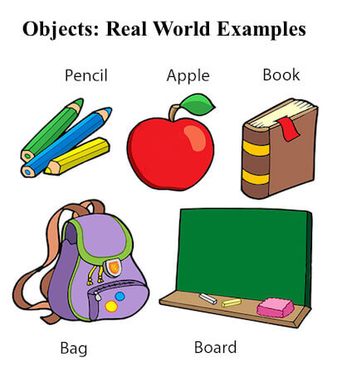
Objects and Classes in Java
An object in Java is the physical as well as a logical entity, whereas, a class in Java is a logical entity only.
What is an object in Java
  An entity that has state and behavior is known as an object e.g., chair, bike, marker, pen, table, car, etc. It can be physical or logical (tangible and intangible). The example of an intangible object is the banking system.

Slide 3
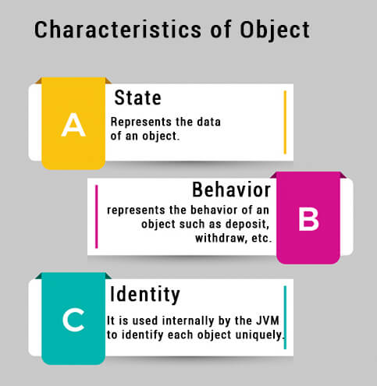
An object has three characteristics:
State: represents the data (value) of an object.
Behavior: represents the behavior (functionality) of an object such as deposit, withdraw, etc.
Identity: An object identity is typically implemented via a unique ID. The value of the ID is not visible to the external user. However, it is used internally by the JVM to identify each object uniquely.

Slide 4
For Example, Pen is an object. Its name is Reynolds; color is white, known as its state. It is used to write, so writing is its behavior.
An object is an instance of a class. A class is a template or blueprint from which objects are created. So, an object is the instance(result) of a class.
Object Definitions:
  An object is a real-world entity.
  An object is a runtime entity.
  The object is an entity which has state and behavior.
  The object is an instance of a class.

Slide 5
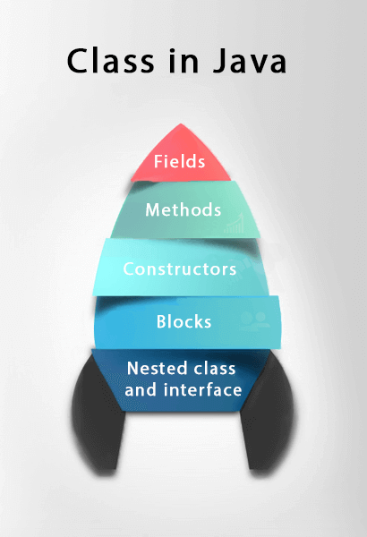
What is a class in Java
A class is a group of objects which have common properties. It is a template or blueprint from which objects are created. It is a logical entity. It can't be physical.
A class in Java can contain:
Fields
Methods
Constructors
Blocks
Nested class and interface

Slide 6

Java Constructors
Constructor in java is a special type of method is used to initialize a object
Java Constructors is invoked at the time of object creation
They do not contain any return types
Constructor name is same as class name

Slide 7

Examples will be available @ my GitHub Repository
https://github.com/Jaeger47/IT123---Java-Examples/tree/main/Class%2C%20Object%2C%20%26%20Constructors

Slide 8
Types of Constructor
Default Constructor
  A constructor is called "Default Constructor" when it doesn't have any parameter.
Parameterized Constructor
  A constructor which has a specific number of parameters is called a parameterized constructor.
  Why use the parameterized constructor?
    The parameterized constructor is used to provide different values to distinct objects. However, you can provide the same values also.

Slide 9
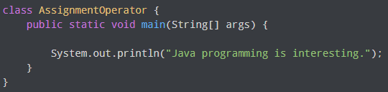
BASIC INPUT and OUTPUT
Java Output
  System.out.println();
  System.out.print();
  System.out.printf();
  System is a class
  out is a public static field: it accepts output data.

Slide 10
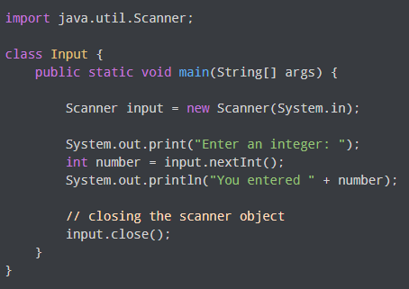
Java Input
  In order to use the object of Scanner, we need to import java.util.Scanner package.
  Then, we need to create an object of the Scanner class. We can use the object to take input from the user.
  We then call the nextInt() method of the Scanner class to get an integer input from the user.
  we can use nextLong(), nextFloat(), nextDouble(), and next() methods to get long, float, double, and string input respectively from the user.
  Note: We have used the close() method to close the object. It is recommended to close the scanner object once the input is taken.

Slide 11
Examples will be available @ my GitHub Repository
https://github.com/Jaeger47/IT123---Java-Examples/tree/main/Basic%20Input%20and%20Output

